Slide 1



Field Data Collection

Slide 2

Field Data Collection
Why collect data in the field?
Advantages and disadvantages
Methods
Field collection tools

Slide 3

Why collect data in the field?
Potential Advantages
‘Ground truth:’ especially for attribute data
Timeliness: when imagery is not readily available
Fiscally sound: no expensive imagery required
Perspective: different than overhead
Coincidental collection: collect additional data enroute
Potential Disadvantages
Accuracy: GPS and ground station availability
Time: traveling to locations
Resource intensive: manpower and time/money
Accessibility: conditions may not permit access

Slide 4
Sampling
Target data collection activity
Human data: Surveys
Validation and verification
Combining imagery analysis and field data collection: complementary data collection
Presence and absence

Slide 5
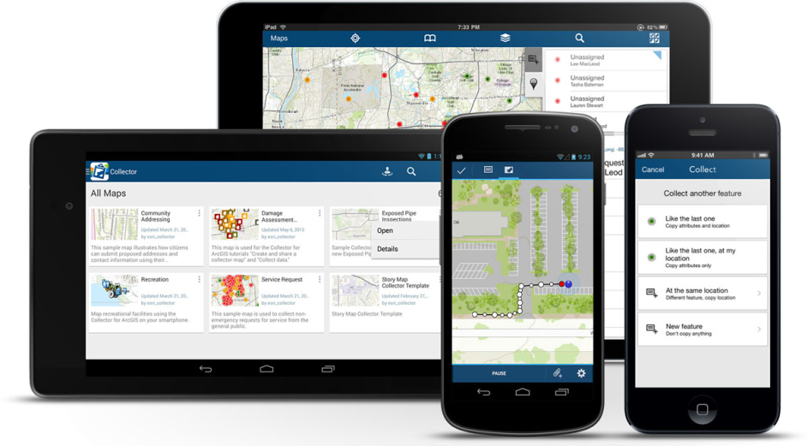
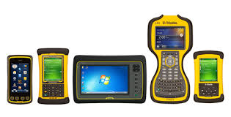
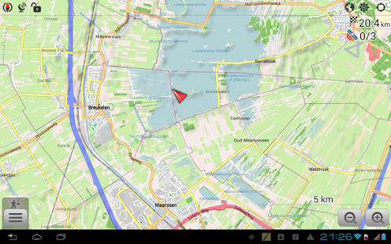
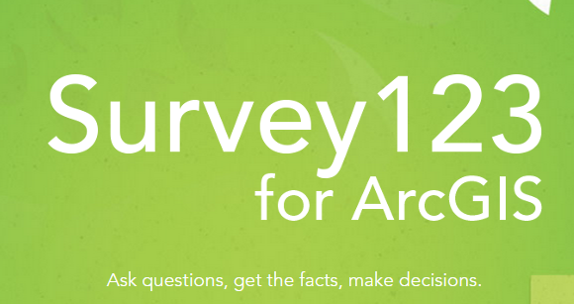

Tools
No shortage of options
Considerations
Online and offline use
Compatibility
Ease of use
Cost
Accuracy and scale required by each project

Slide 6
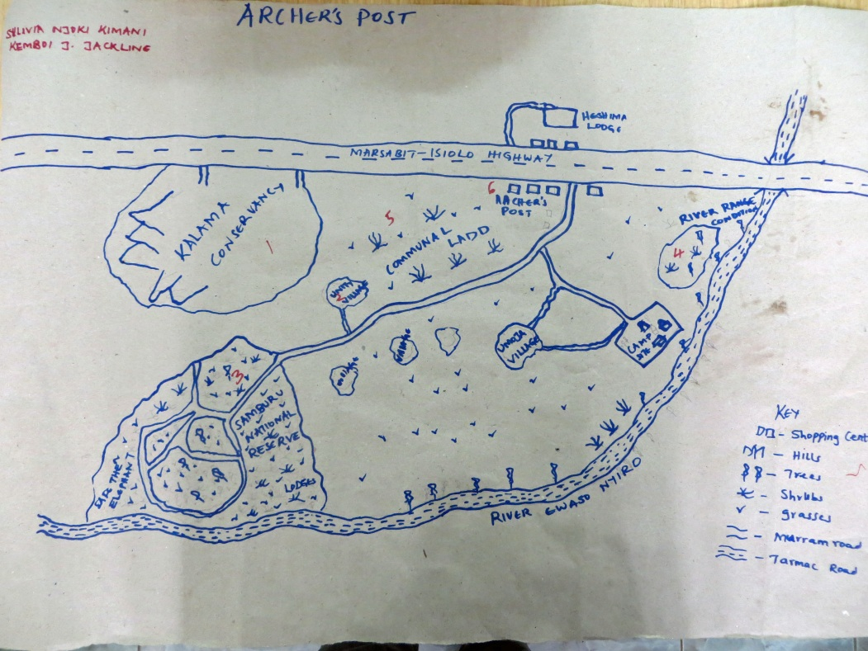
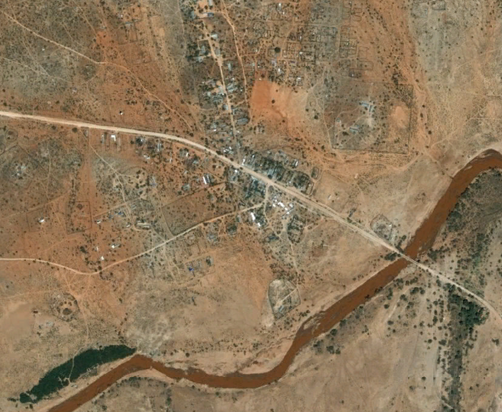
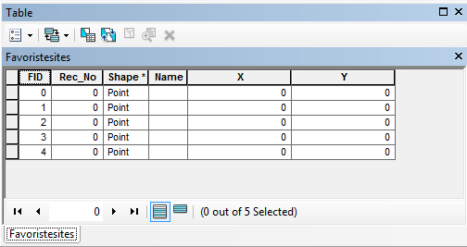
Exercise: Converting Field Data into Digital Data; Situating your points on a satellite image
Creating attribute information

Slide 7

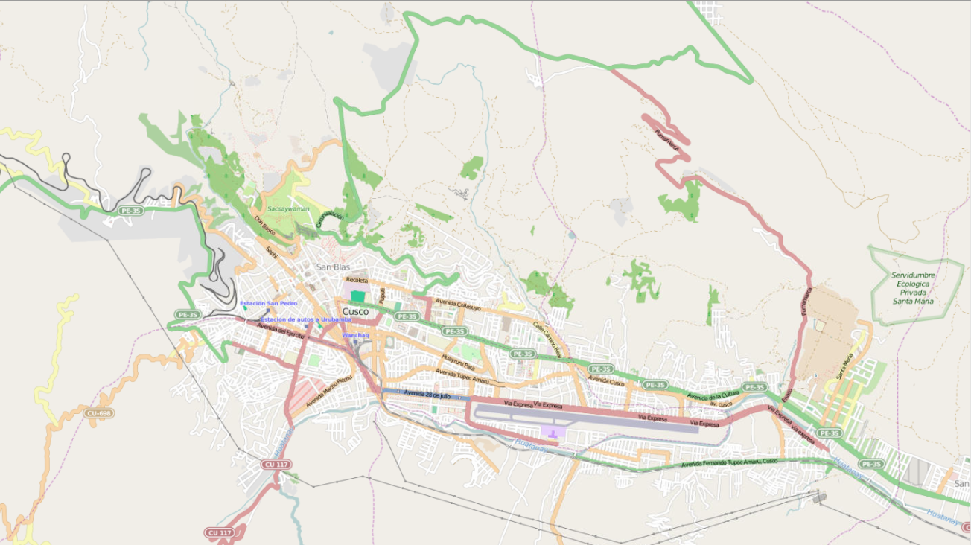
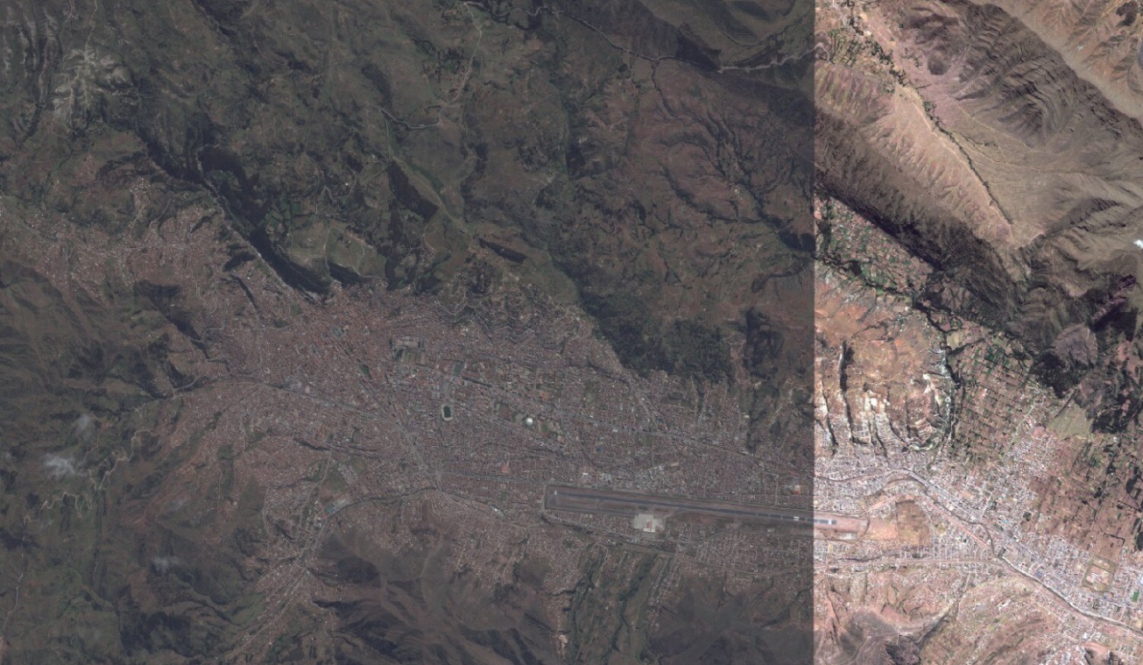
OpenStreetMap:
Open data collected by a community of mappers
ESRI Imagery: May 2015

Slide 8
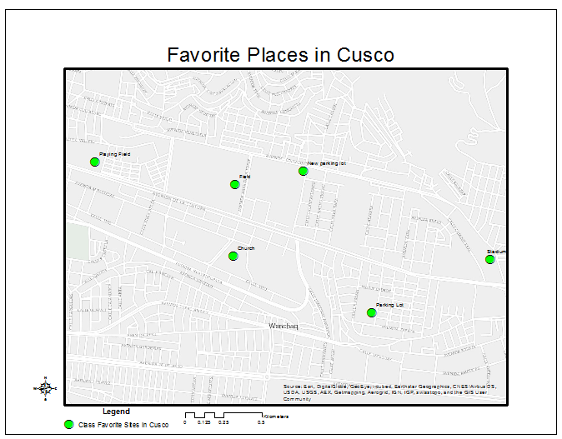
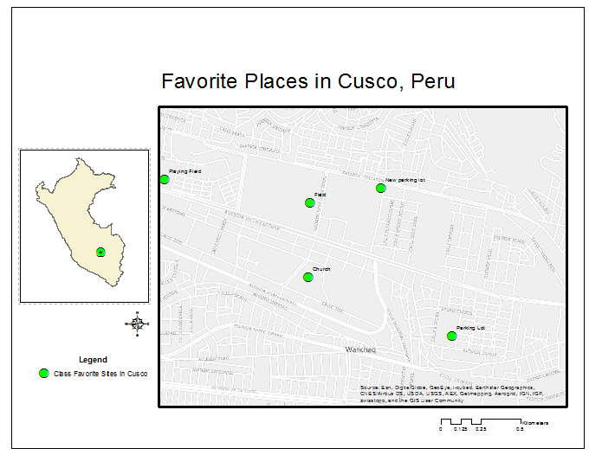
Make a Map

Slide 9
Exercise 3: Collecting Field Data & Converting Field Data into Digital Data
Field Data collection
Survey123
ArcGIS OnLine
Collect data in field based upon a HG theme:
You will be given a point to navigate to…
Collect 2 more HG points
Return to computer lab
Data sharing
CuscoGeoNode
1
Notes:
The Digital Globe commercial imagery is being provided by the US Government as part of the NextView License. By sharing this imagery with you for the Secondary Cities workshop, you become a temporary licensed user, and we have to ask you to follow these restrictions.
You must properly mark the Copyright and License information on all imagery-derived products. (Any graphics that display this imagery). The marking to be used is: “© 2015, Digital Globe. NextView License.”, using the year of the imagery as the year for the copyright.
Do not share the raw data or a copy of these images with non-licensed users without express permission from the USG.
Do not use this imagery or image derived products for commercial gain or make this imagery publically available.
Derived datasets and products are unrestricted….as long as there is no imagery with the product (as a background or otherwise).
Information to highlight for Santos, as the administrator for this project:
These restrictions apply in perpetuity (…this imagery must be used for USG benefit. It must not be used for commercial gain or made publically available [posting the raw data or publishing image graphics].)
He needs to control access to the imagery to only those participating in this project – eg password protection.

Slide 10
Exercise: Converting Field Data into Digital Data; Situating your points on a satellite image
Creating attribute information

Slide 11
OpenStreetMap:
Datos abiertos
recopiladas por
comunidad de
maneadores
ESRI Imagery: May 2015

Slide 12
Hacer un Mapa

